Slide 1
Chapter No.3 Input & Output Devices

Slide 2
Output Devices

Slide 3
Output Devices
Following are some of the important output devices used in a computer −
Monitors
Plotter
Printer

Slide 4
Monitors
Monitors, commonly called as Visual Display Unit (VDU), are the main output device of a computer. It forms images from tiny dots, called pixels that are arranged in a rectangular form. The sharpness of the image depends upon the number of pixels.

Slide 5
Types of Monitors
There are two kinds of viewing screen used for monitors.
Cathode-Ray Tube (CRT)
Flat-Panel Display

Slide 6
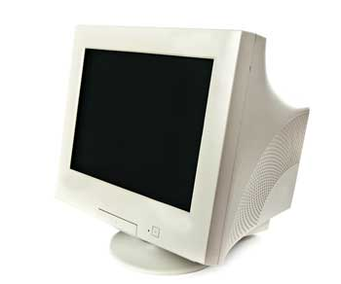
Cathode-Ray Tube (CRT) Monitor
The CRT display is made up of small picture elements called pixels. The smaller the pixels, the better the image clarity or resolution. It takes more than one illuminated pixel to form a whole character, such as the letter ‘e’ in the word help.
A finite number of characters can be displayed on a screen at once. The screen can be divided into a series of character boxes - fixed location on the screen where a standard character can be placed. Most screens are capable of displaying 80 characters of data horizontally and 25 lines vertically.

Slide 7
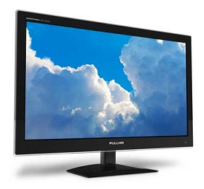
Flat-Panel Display Monitor
The flat-panel display refers to a class of video devices that have reduced volume, weight and power requirement in comparison to the CRT. You can hang them on walls or wear them on your wrists. Current uses of flat-panel displays include calculators, video games, monitors, laptop computer, and graphics display.

Slide 8
Categories of flat-panel display
The flat-panel display is divided into two categories −
Emissive Displays −
Emissive displays are devices that convert electrical energy into light. For example, plasma panel and LED (Light-Emitting Diodes).
Non-Emissive Displays −
Non-emissive displays use optical effects to convert sunlight or light from some other source into graphics patterns. For example, LCD (Liquid-Crystal Device).

Slide 9
Printers
Printer is an output device, which is used to print information on paper.
There are two types of printers −
Impact Printers
Non-Impact Printers

Slide 10
Impact Printers
Impact printers print the characters by striking them on the ribbon, which is then pressed on the paper.
Characteristics of Impact Printers are the following −
Very low consumable costs
Very noisy
Useful for bulk printing due to low cost
There is physical contact with the paper to produce an image

Slide 11
Types of Impact Printers
These printers are of two types −
Character printers
Dot Matrix Printer(DMP)
Daisy Wheel
Line printers
Drum Printer
Chain Printer

Slide 12
Character Printers
Character printers are the printers which print one character at a time.
These are further divided into two types:
Dot Matrix Printer(DMP)
Daisy Wheel

Slide 13
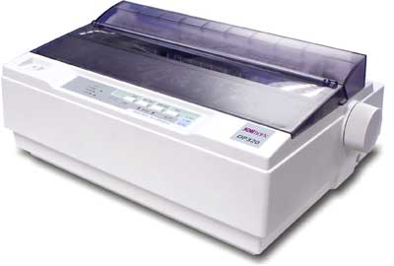
Dot Matrix Printer
In the market, one of the most popular printers is Dot Matrix Printer. These printers are popular because of their ease of printing and economical price. Each character printed is in the form of pattern of dots and head consists of a Matrix of Pins of size (5*7, 7*9, 9*7 or 9*9) which come out to form a character which is why it is called Dot Matrix Printer.
Advantages
Inexpensive
Widely Used
Other language characters
can be printed
Disadvantages
Slow Speed
Poor Quality

Slide 14
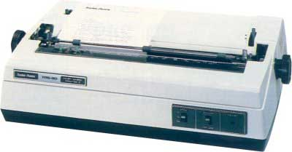
Daisy Wheel
Head is lying on a wheel and pins corresponding to characters are like petals of Daisy (flower) which is why it is called Daisy Wheel Printer. These printers are generally used for word-processing in offices that require a few letters to be sent here and there with very nice quality.
Advantages
More reliable than DMP
Better quality
Fonts of character can be
easily changed
Disadvantages
Slower than DMP
Noisy
More expensive than DMP

Slide 15
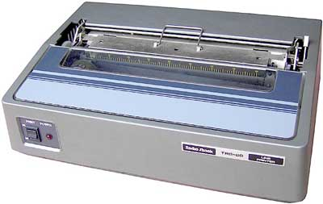
Line Printers
Line printers are the printers which print one line at a time.
These are of two types −
Drum Printer
Chain Printer

Slide 16
Drum Printer
This printer is like a drum in shape hence it is called drum printer. The surface of the drum is divided into a number of tracks. Total tracks are equal to the size of the paper, i.e. for a paper width of 132 characters, drum will have 132 tracks. A character set is embossed on the track. Different character sets available in the market are 48 character set, 64 and 96 characters set. One rotation of drum prints one line. Drum printers are fast in speed and can print 300 to 2000 lines per minute.
Advantages
Very high speed
Disadvantages
Very expensive
Characters fonts cannot be changed

Slide 17
Chain Printer
In this printer, a chain of character sets is used, hence it is called Chain Printer. A standard character set may have 48, 64, or 96 characters.
Advantages
Character fonts can easily be changed.
Different languages can be used with the same printer.
Disadvantages
Noisy

Slide 18
Non-impact Printers
Non-impact printers print the characters without using the ribbon. These printers print a complete page at a time, thus they are also called as Page Printers.
Characteristics of Non-impact Printers
Faster than impact printers
They are not noisy
High quality
Supports many fonts and different character size

Slide 19
Types of Non-Impact Printers
These printers are of two types −
Laser Printers
Inkjet Printers

Slide 20
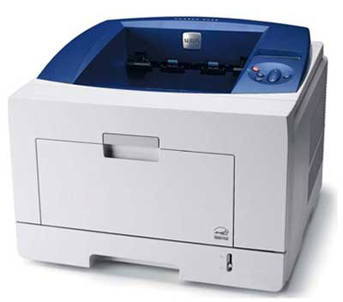
Laser Printers
These are non-impact page printers. They use laser lights to produce the dots needed to form the characters to be printed on a page.
Advantages
Very high speed
Very high quality output
Good graphics quality
Supports many fonts and
different character size
Disadvantages
Expensive
Cannot be used to produce multiple copies of a document in a single printing.

Slide 21
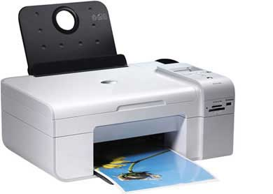
Inkjet Printers
Inkjet printers are non-impact character printers based on a relatively new technology. They print characters by spraying small drops of ink onto paper. Inkjet printers produce high quality output with presentable features.
They make less noise because no hammering is done and these have many styles of printing modes available. Color printing is also possible. Some models of Inkjet printers can produce multiple copies of printing also.
Advantages
High quality printing
More reliable
Disadvantages
Expensive as the cost
per page is high
Slow as compared to laser printer

Slide 22
Plotters
A plotter is a special output device used to produce hard copies of large graphs and designs on paper, such as construction maps, engineering drawings, architectural plans and business charts. The plotter is either a peripheral component that you add to your computer system or a standalone device with its own internal processor.

Slide 23
Types of Plotters
Following are two types of plotter
Drum Plotter
Flat-Bed Plotter

Slide 24
Drum Plotter
The drum plotter was the first output device for printing graphics. A drum plotter contains a pen, drum, paper, and ink for output. In this drum rotates the pages and pens draw the images on papers. The drum rotates to change the position of the paper. The length of image is limited. It is because of the limited size of the drum.

Slide 25
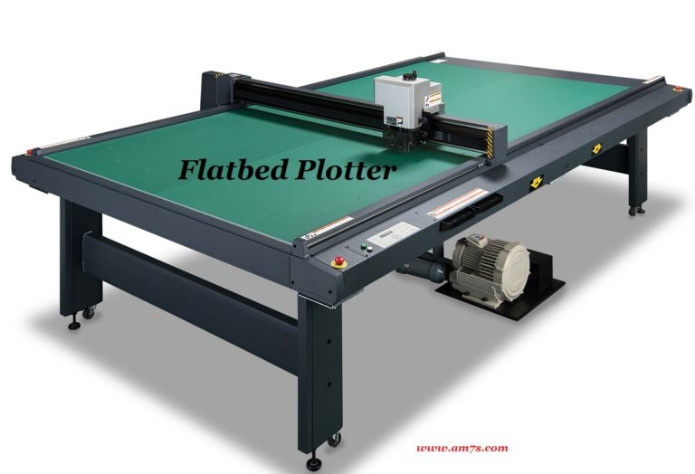
Flatbed Plotter
A flatbed plotter is used with many CAD programs for designs. In this plotter writing pen move x-axis and y-axis direction to draw the image. The papers remain stationary on the surface of the flatbed plotter. Different types of pens are used to draw a colorful sketch. The size of the images depends on the size of the flatbed plotter.

Slide 26
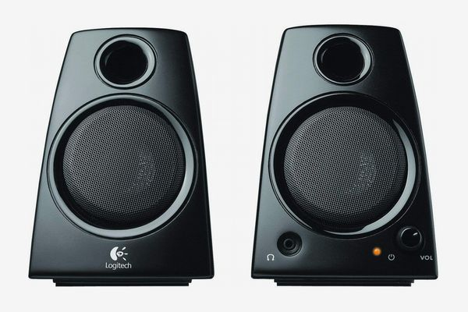
Speakers
Speakers are popular output devices used with computer systems. They receive audio input from the computer's sound card and produce audio output in the form of sound waves.

Slide 27
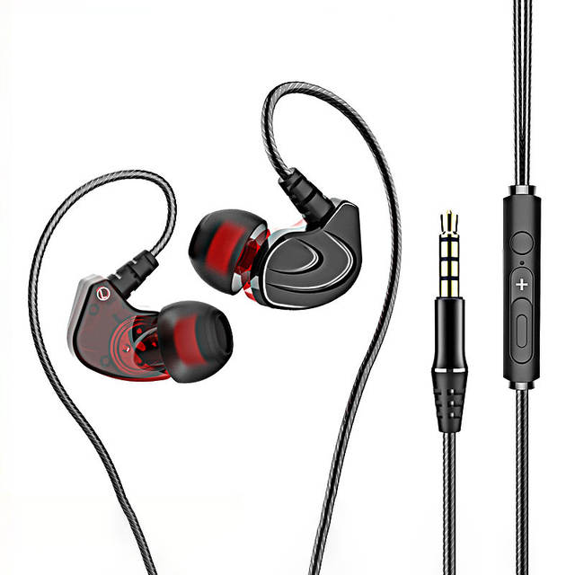
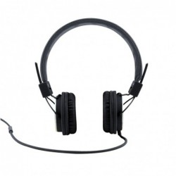
Headphones
Headphones are small speakers that can be worn in or around your ears. Traditional headphones have two ear cups attached by a band that is placed over your head. Smaller headphones, often called earbuds or earphones, are placed inside the outer part of your ear canal.

